Slide 1
OECD WORK ON
WELL-BEING AND SDGS:
ReflectionS in the context of project makswell
Pisa, 10 may 2018
Carrie Exton
Head of Section, Measuring Well-Being and Progress
OECD Statistics Directorate

Slide 2
Outline: OECD work and some themes/ objectives from Project MAKSWELL
MAKing Sustainable development and WELL-being frameworks work for policy analysis
Framework development and database building
→ OECD work on well-being (WB) and the Sustainable Development Goals (SDGs)
Filling the data gaps
→ What is needed for a more complete picture on WB and SDGs?
Policy uses
→ Of well-being and sustainable development metrics. What does current practice look like? Where could it go next?

Slide 3


Statistics Directorate: Better Data
→ Policy-makers need feedback:
  Is life is getting better, and for whom?
  Which policies make life better? Which ones don’t?
→ People (incl. civil society, media, private sector) need feedback:
  To hold policy-makers to account
  To inform decisions
Notes:
3

Slide 4
My team sits somewhere between data producers and data users
Government/ policy
National statistical office data
Communication/ media
Civil society
OECD “produced” data (PISA, PIAAC, environment, governance)
Private sector
Research community
Non-official data as placeholders (e.g. Gallup; ESS)
Communication/ media
General public

Slide 5
But we’re not just passive data munchers!
Government/ policy
National statistical office data
e.g. committee procedures
e.g. measurement guidelines
Civil society
OECD “produced” data (PISA, PIAAC, environment, governance)
Private sector
Research community
Non-official data as placeholders (e.g. Gallup; ESS)
e.g. shaping demand for data
General public
e.g. through the Better Life Index

Slide 6
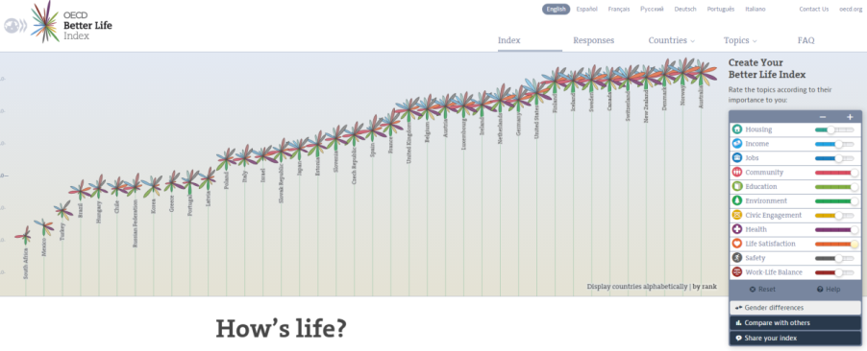
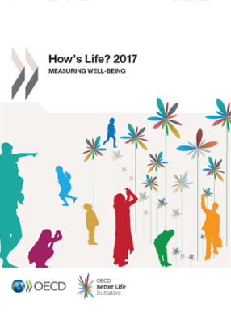
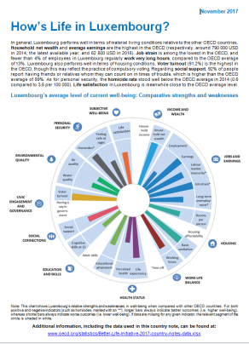
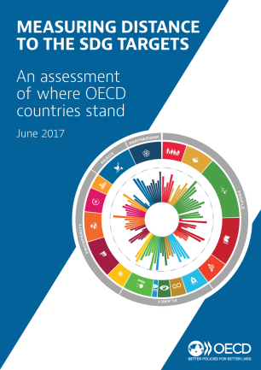
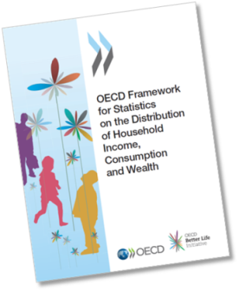
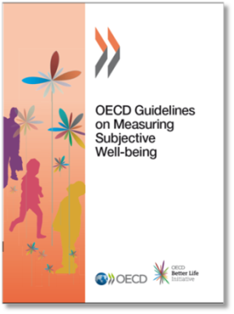
Public outreach
Reporting & analysis
Research & methodological work
TrustLab

Slide 7
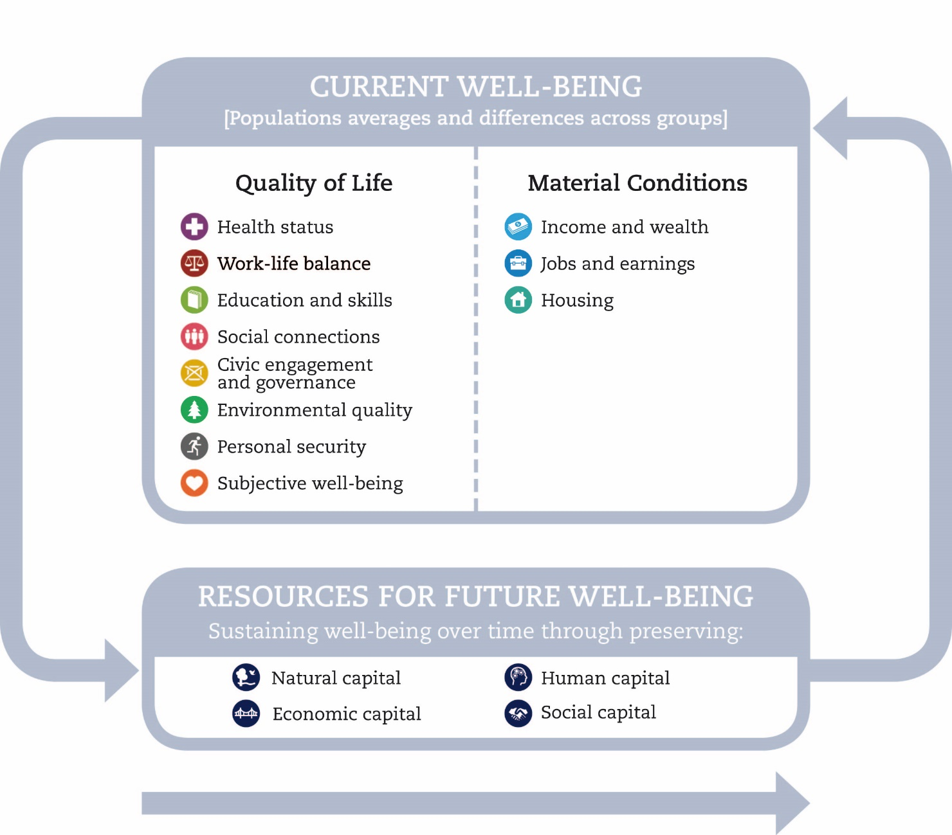
Measuring well-being: the OECD approach
A focus on people rather than the economic system or GDP
Measures outcomes rather than inputs and outputs
Examines both averages and inequalities
Considers both objective and subjective aspects
Concerned with well-being both today and tomorrow

Slide 8
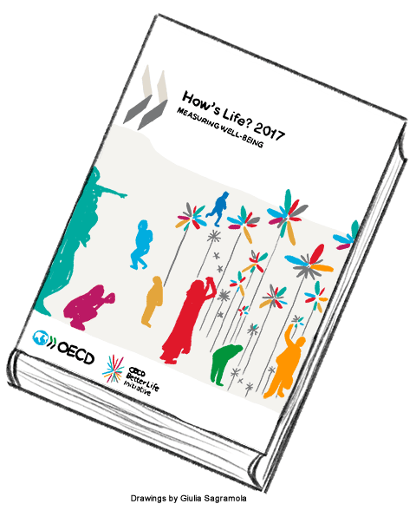
How’s Life? – the OECD’s well-being report
Fourth edition released November 2017
Overview of levels and trends in well-being since 2005 (current well-being, resources for future well-being)
Three thematic chapters:
  Inequalities in well-being
  Migrants’ well-being
  Governance and well-being
Detailed country notes for 35 OECD members and 6 partners

Slide 9
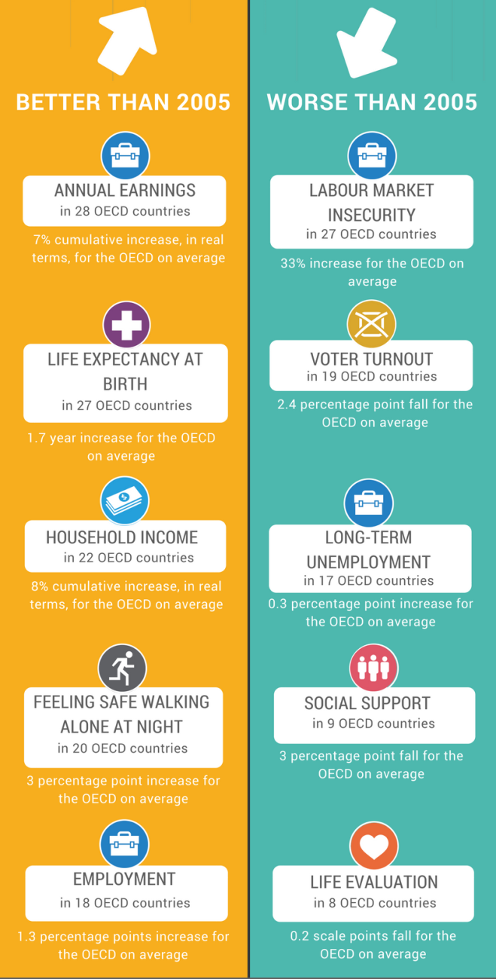
Change in well-being relative to 2005
In some aspects of life the average OECD resident is now better off than in 2005…
but progress has often been slow, and unevenly distributed across countries…
…and in some areas well-being is falling behind
→ Highlights importance of a multidimensional approach and the need to look beyond the average

Slide 10
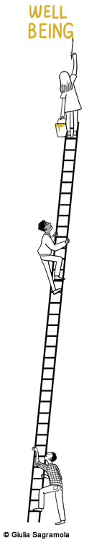
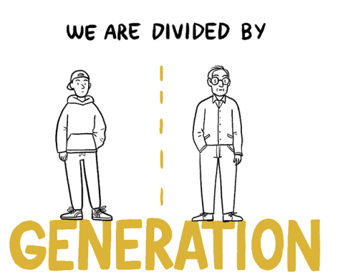

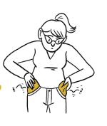

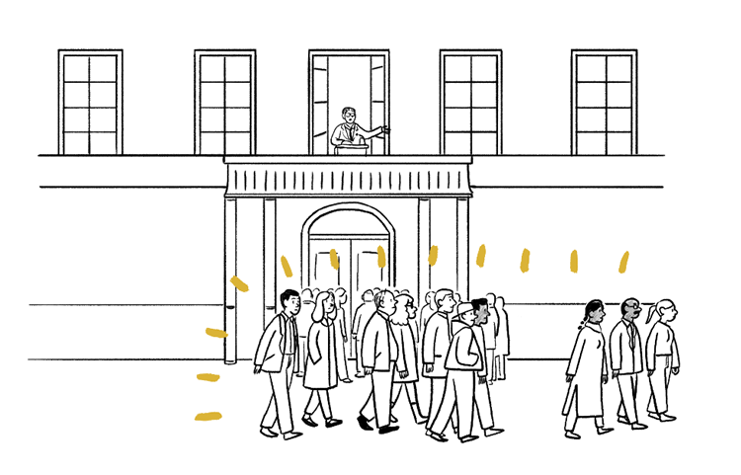
Well-being inequalities persist across all dimensions (not just income)
How’s Life? 2017 examines divisions among individuals
(“vertical inequalities”)
divisions among population groups (“horizontal inequalities”)
          gender
          age
          education
          migrant status
                …and between people and the public institutions that serve them
All illustrations © Guilia Sagramola

Slide 11
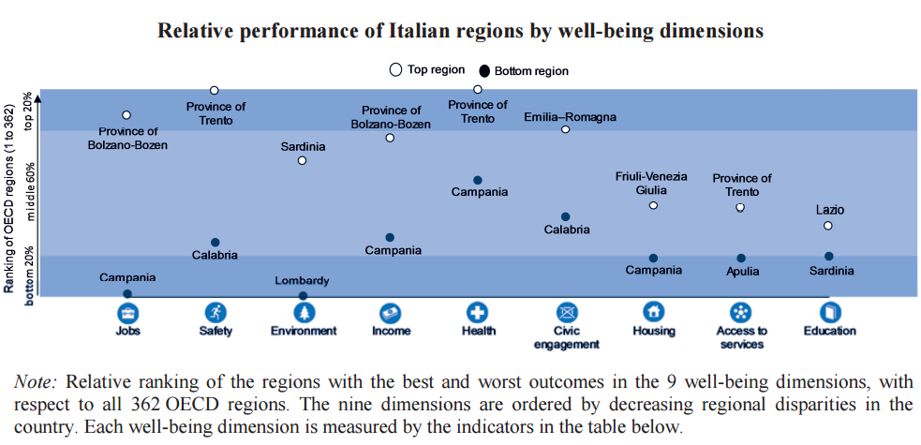
Well-being inequalities across 362 OECD regions
https://www.oecdregionalwellbeing.org/

Slide 12
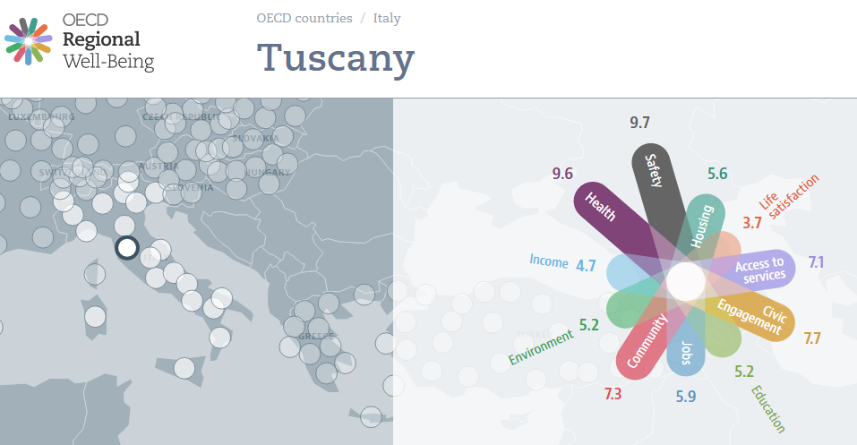
www.oecdregionalwellbeing.org

Slide 13
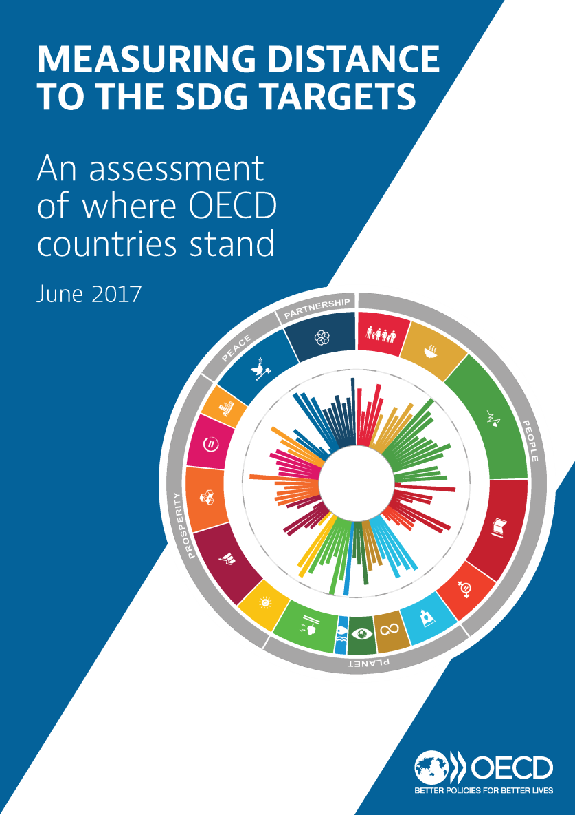
OECD study on Measuring Distance to the SDG targets
Tool to help identify priorities for action and communicate on challenge of SDGs
Assesses countries’ distance from the SDG targets. High-level overview of strengths, weaknesses and measurement gaps
Piloted in 2016; updated in June 2017
Participation is voluntary: 6 countries participated in pilot phase; 7 additional countries have since joined; ongoing discussion with 10 more
Participated in 2017: Belgium, the Czech Republic, Denmark, Finland, Italy, Korea, Luxembourg, Latvia, the Netherlands, Norway, Slovenia, the Slovak Republic and Sweden.

Slide 14
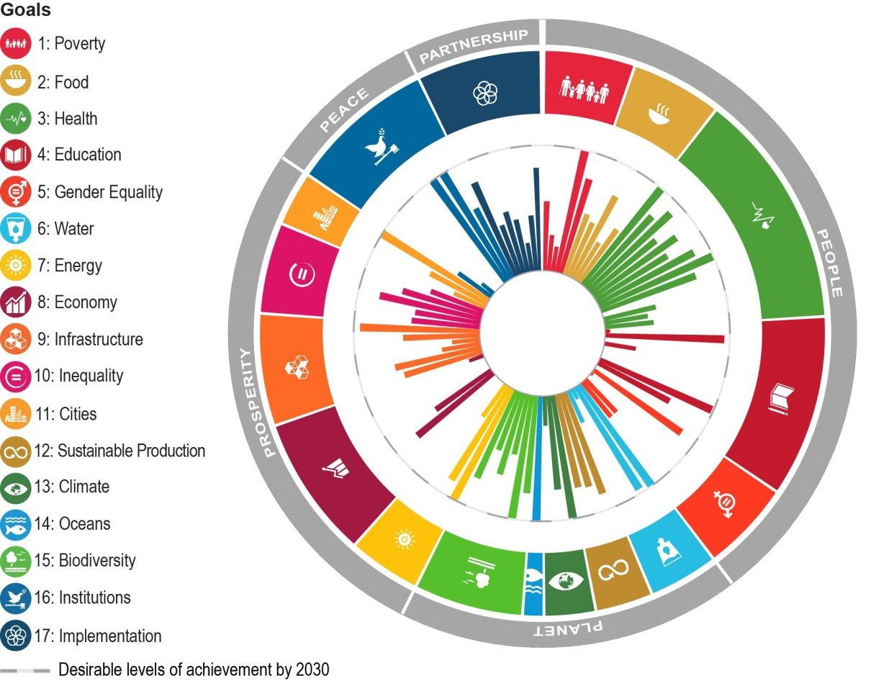
Italy’s current distance from achieving the SDGs’ 2030 targets
Based on the 128 available indicators allowing coverage of 96 of the 169 SDG targets, Italy has currently achieved 11 of the 2030 targets.
Note: The chart shows how far Italy has already progressed towards each available target. The longer the bars the shorter the distance is to be travelled by 2030. Targets are clustered by goal, and goals are clustered by the “5Ps” of the 2030 Agenda (outer circle).

Slide 15
Italy’s current distance from each of the Goals and “5Ps” of the 2030 Agenda
Based on the 128 available indicators allowing coverage of 96 of the 169 targets…
Note: This figure shows Italy’s distance to travel towards each of the 17 Goals of the 2030 Agenda. Bars show Italy’s performance, while diamonds show the OECD average. White bars indicate missing data. The y-axis indicates the distance from reaching the target in standardised units. 0 indicates that the level for 2030 has already been attained, and the axis starts at 3 as most OECD countries have already attained this level. Distances to target are aggregated at the goal level (all targets weighted equally). To make the level of achievement within the country more distinct, in this figure, data on Official Development Assistance (ODA) are excluded in Goals 1 to 16. Nonetheless, total ODA, ODA focusing on capacity building and national planning as well as ODA commitments to statistical capacity building are included in Goal 17 “implementation” and under Partnership.

Slide 16















OECD well-being framework |  |  | Sustainable Development Goals
Current well-being |  | Income & wealth | SDG 1 (poverty); SDG 2 (food)
 |  | Jobs and earnings | SDG 8 (decent work & economy)
 |  | Housing | SDG 11 (cities)
 |  | Health status | SDG 3 (health)
 |  | Work-life balance | SDG 8 (decent work & economy)
 |  | Education & skills | SDG 4 (education)
 |  | Civic engagement & governance | SDG 16 (institutions)
 |  | Environmental quality | SDG 6 (water); SDG 11 (cities)
 |  | Personal security | SDG 16 (institutions)
Inequalities |  | [captured throughout all dimensions] | SDG 1 (poverty); SDG 5 (women); SDG 10 (inequality)
Resources for future well-being |  | Natural capital | SDG 13 (climate); SDG 14 (oceans); SDG 15 (biodiversity); SDG 12 (sustainable production)
 |  | Economic capital | SDG 7 (energy); SDG 8 (work & economy); SDG 9 (infrastructure); SDG 12 (sustainable production)
 |  | Human capital | SDG 3 (health); SDG 4 (education)
 |  | Social capital | SDG 16 (institutions)

Slide 17
Elements of OECD well-being framework not well-covered by SDGs |  | Subjective well-being
 |  | Social connections
 |  | Social capital (trust elements, volunteering, voting etc.)
Elements of SDGs not well-covered by OECD well-being framework |  | SDG 17 (implementation)
 |  | "Global contributions, trans-boundary effects, international efforts"

Slide 18
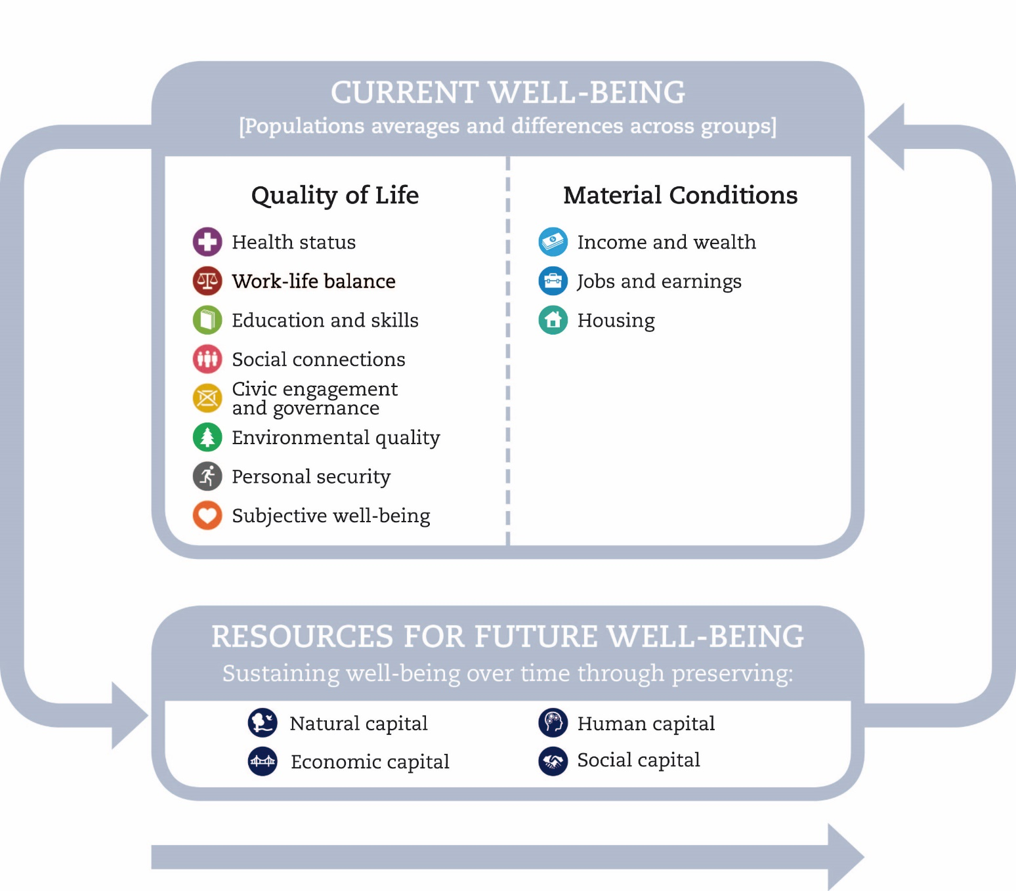
Well-being data gaps
(as assessed against the How’s Life? framework)

Slide 19
Statistical agenda ahead on well-being
(see How’s Life? 2017 for details)
Incomplete country coverage: sometimes due to lack of harmonised approach, sometimes due to absent data (e.g. Time Use Surveys)
Incomplete time series: several indicators are not collected on a regular basis and/or methodological breaks hamper interpretation
e.g. no time series for trust; threatened species; time devoted to leisure and personal care; adult skills; having a say in government; volunteering
Challenges to disaggregate across groups to study inequalities : Many indicators submitted to OECD as national averages; often lack access to micro data for breakdowns/inequality estimation
Unofficial sources still being used as placeholders, 7 years later…
Some progress (e.g. life satisfaction) but little movement on social connections, feelings of safety, perceived water quality…

Slide 20
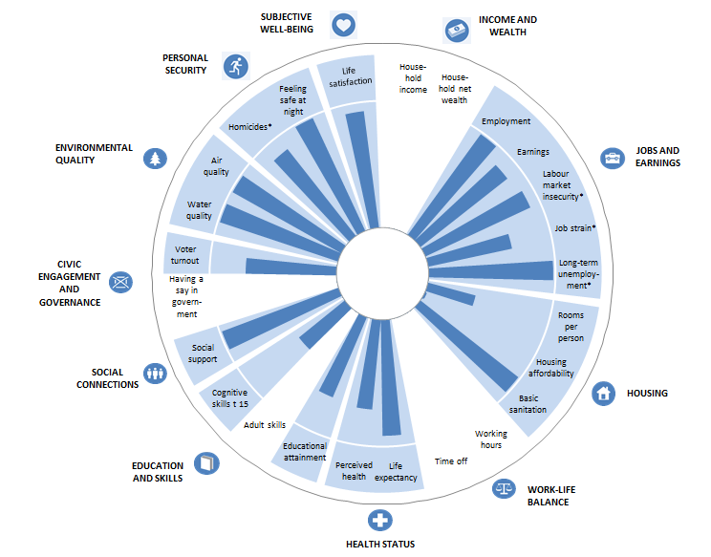
How’s Life? 2017 highlights data gaps e.g. Iceland’s average level of current well-being

Slide 21
Incomplete country coverage
Country coverage gaps for current well-being include:
time devoted to leisure and personal care (missing for 14 OECD countries)
household net wealth (missing for 8)
adult skills (7)
having a say in government (7)
life satisfaction (missing for 5)
On resources for future well-being, there are sizeable gaps on:
produced fixed assets and intellectual property assets (9)
trust in others and trust in the police (8)
volunteering (7)
household debt (5)
and threatened species (3-5)

Slide 22
Several elements are missing altogether
Current well-being
social connections poorly captured: 1 headline indicator, based on a simple “yes/no” question from non-official source. Often has ceiling effects.
personal safety: Only able to capture the extremes. Internationally comparable data on the incidence of crimes, other than homicide, should be a priority for the future.
environmental quality, there are important data gaps to fill regarding access to green space and objective measures of water quality.
As yet, it has also not been possible to identify a suitable measure of mental health for the health status dimension, a major omission.
Resources for future well-being
Human, economic and particularly natural and social capital have important gaps in terms of the concepts covered – and the issues of global public goods and transboundary impacts require further conceptual and statistical work.

Slide 23
SDG data gaps: Indicators used in OECD Measuring Distance study
Indicators selected based on UN IAEG list and complemented by OECD data:
OECD data for indicators comparable to UN global framework (65)
OECD proxies for UN indicators where UN does not yet have data (14)
UN data where no OECD sources exist (37)
Additional relevant OECD indicators (15)
A Maximum of 128 indicators covering 98 (out of 169) targets
i.e. 71 (42%) of targets have no indicators

Slide 24
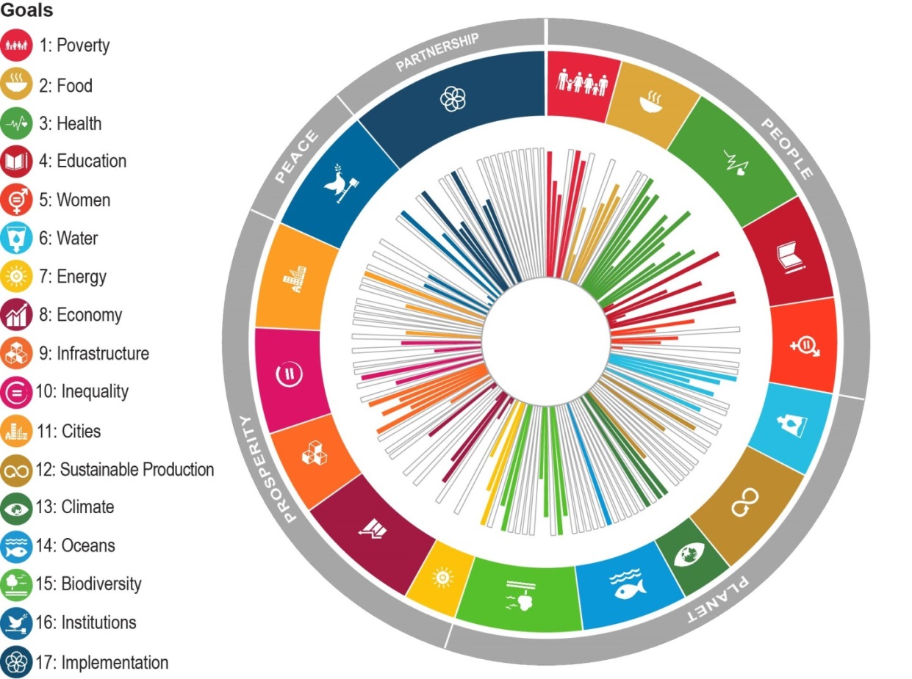
SDG data gaps, by target

Slide 25
SDG data gaps: by goal
Percentage of targets in each goal covered by at least 1 indicator (OECD countries)

Slide 26
SDG data gaps: by the “5Ps”
Percentage of targets in each of the 5Ps covered by at least 1 indicator (OECD countries)

Slide 27
e.g. Goal 11 “Make cities and human settlements inclusive, safe, resilient and sustainable”
  10 targets (11.1 – 11.7, 11a, 11b, 11c)
  15 indicators selected by the UN Inter-Agency and Expert Group for global monitoring purposes
  UN Global SDG Indicator Database contains at least some data for 3/15 indicators (i.e. 20%) …but this by no means covers all countries
Target | UN IAEG Global List Indicator | UN Global SDG Indicator Database data series
11.1 | 11.1.1 Proportion of urban population living in slums, informal settlements or inadequate housing | Proportion of urban population living in slums
11.5 | 11.5.2 Direct economic loss in relation to global GDP, damage to critical infrastructure and number of disruptions to basic services, attributed to disasters | The Global database has 5 datasets for this indicator.
11.6 | 11.6.2 Annual mean levels of fine particulate matter (e.g. PM2.5 and PM10) in cities (population weighted) | Annual mean levels of fine particulate matter in cities

Slide 28
Goal 11: Cities 80% of indicators have no data in the UN Global SDG Indicator database
Target | UN IAEG Global List Indicator
11.2 | 11.2.1 Proportion of population that has convenient access to public transport, by sex, age and persons with disabilities
11.3 | 11.3.1 Ratio of land consumption rate to population growth rate
 | 11.3.2 Proportion of cities with a direct participation structure of civil society in urban planning and management that operate regularly and democratically
11.4 | 11.4.1 Total expenditure (public and private) per capita spent on the preservation, protection and conservation of all cultural and natural heritage…
11.5 | 11.5.1 Number of deaths, missing persons and directly affected persons attributed to disasters per 100,000 population
11.6 | 11.6.1 Proportion of urban solid waste regularly collected and with adequate final discharge out of total urban solid waste generated, by cities
11.7 | 11.7.1 Average share of the built-up area of cities that is open space for public use for all, by sex, age and persons with disabilities
 | 11.7.2 Proportion of persons victim of physical or sexual harassment, by sex, age, disability status and place of occurrence, in the previous 12 months
11.a | 11.a.1 Proportion of population living in cities that implement urban and regional development plans integrating population projections and resource needs, by size of city
11.b | 11.b.1 Number of countries that adopt and implement national disaster risk reduction strategies in line with the Sendai Framework for Disaster Risk Reduction 2015–2030
 | 11.b.2 Proportion of local governments that adopt and implement local disaster risk reduction strategies in line with national disaster risk reduction strategies
11.c | 11.c.1 Proportion of financial support to the least developed countries that is allocated to the construction and retrofitting of sustainable, resilient and resource-efficient buildings utilizing local materials

Slide 29
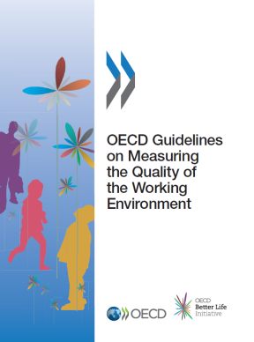
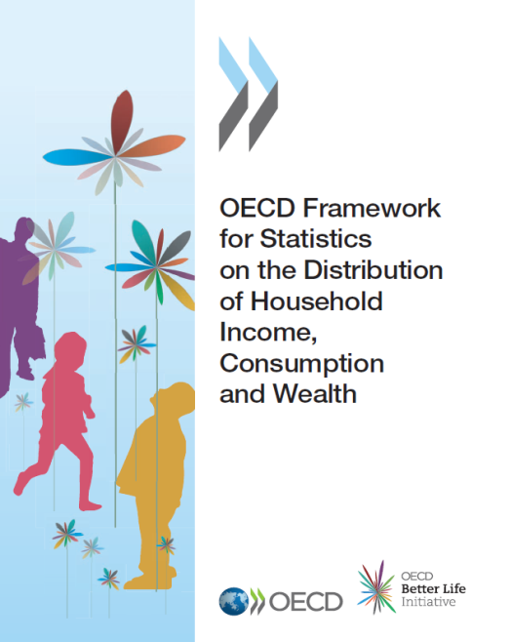
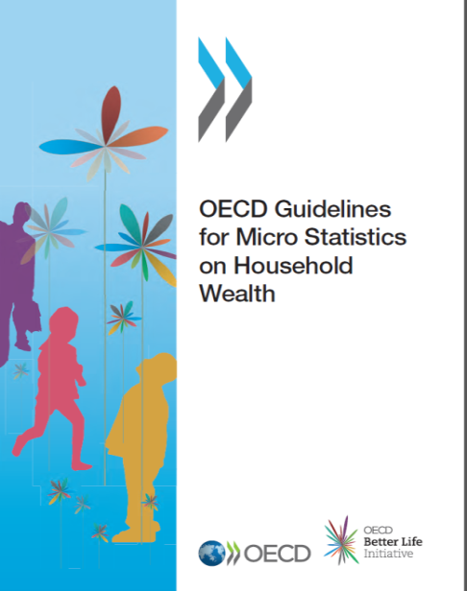
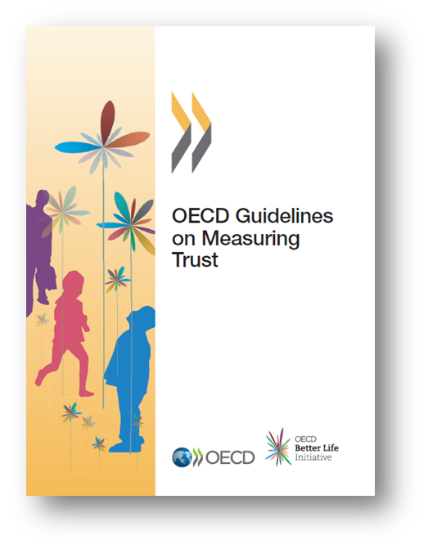
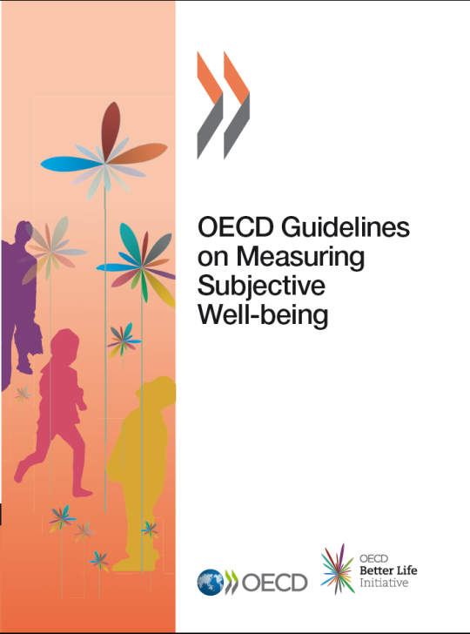
Continuous efforts to improve the data
OECD Measurement guidelines:
(Subjective well-being, Household wealth, Joint distributions of income, consumption & wealth, Quality of the work environment, Trust)
Well-being in OECD data collections
(e.g. PISA, PIAAC, TrustLab)
Supporting UN IAEG on SDGs
(OECD data used in some cases)
Developing innovative methods
(e.g. Trustlab experimental techniques; satellite data for environmental stats)
OECD Smart Data Strategy

Slide 30
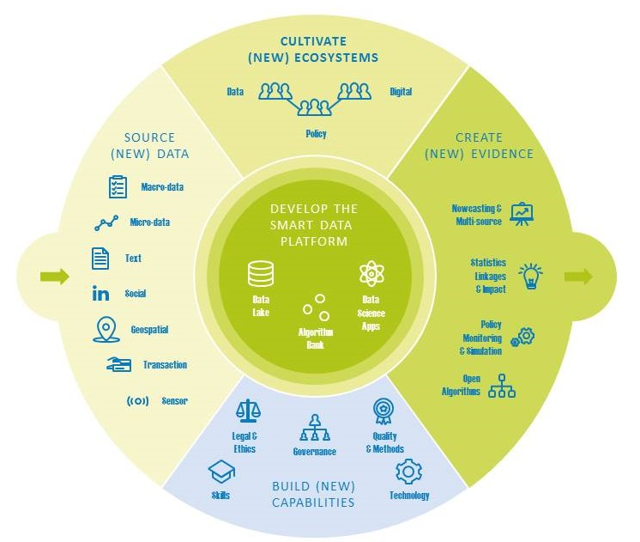
OECD Smart Data Strategy

Slide 31
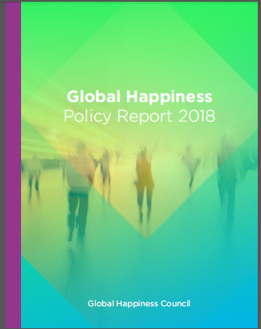
Policy use of well-being metrics
OECD (Chapter 8):
Countries’ Experiences with Well-being and Happiness Metrics
13 countries with well-being measurement frameworks
10 countries with specific mechanisms for embedding well-being metrics in policy
7 detailed case studies
  http://bit.ly/countries-well-being

Slide 32

Use of well-being metrics in the policy cycle
Agenda setting
Monitoring
Evaluation
Implementation
Policy formulation
The Policy Cycle

Slide 33
7 national (central govt) case studies considered in the report
Scotland
Sweden
Agenda setting
Monitoring
Evaluation
Implementation
Policy formulation
Italy
Ecuador
France
The Policy Cycle
New Zealand
United Kingdom

Slide 34
5 observations from country experiences
Countries’ frameworks for well-being are multi-dimensional (i.e. consider several different aspects of people’s lives)
Most frameworks include subjective well-being measures, but not always as a headline indicator for analysis
Well-being metrics are used at different stages of the policy cycle, from strategic analysis, to evaluations of policy interventions
Efforts initiated in different institutions in different countries (Prime Minister, Cabinet, Parliament, National Statistical Offices) with varying commitment and results
Still early days: progress has been significant in last decade, but most initiatives are young, and still evolving. Durability over time will be crucial.

Slide 35
  Thanks for listening!
  www.oecd.org/statistics/measuring-well-being-and-progress.htm
  www.oecd.org/howslife
  http://bit.ly/countries-well-being
  carrie.exton@oecd.org
Notes:
35

Slide 36
Recap: Project MAKSWELL objectives
MAKing Sustainable development and WELL-being frameworks work for policy analysis
building up a database on beyond GDP initiatives for a wide set of EU countries
improving the database on beyond GDP initiatives
extending the geographical dimension especially focusing on the possible estimates of people’s vulnerability (e.g. poverty; regional inflation)
using the extended database for policy evaluation at macro level

Slide 37
Makswell reflection paper: “Future research needs in terms of statistical methodologies and new data”
Themes of action
New data: for Agenda 2030 and Beyond GDP
2. Methodologies for new sources: complementing surveys with administrative data and other new data sources like big data.
3. Assessment capacity : development of innovative policy tools; more service-oriented statistics
4. Skills and competence development : developing basic knowledge of statistics among citizens
5. Building a data-friendly environment : Managing and fruitfully utilising the data deluge implies finding an effective regulatory framework for data production, sharing and dissemination.

